Slide 1
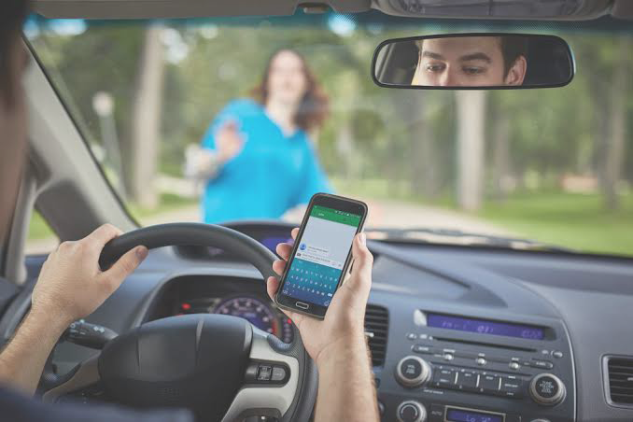
Problem Code: UK149
Ministry Category: ARAI
Problem Statement: Warning System for Driver
College Code:
Team Leader Name: ABC

Slide 2
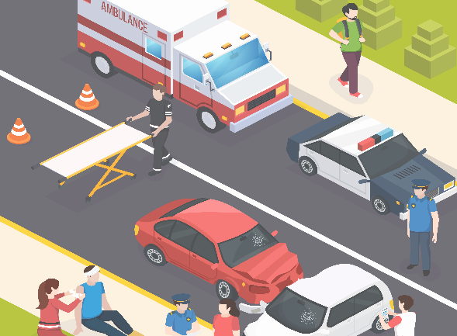
Why do we need this system?
The numbers of vehicles is increasing day by day. Now a days, the technology has got vast changes which leads increase in speed. The common braking is not sufficient for avoidance of accidents when driver is not active. Further improvement has to be done an order to break a vehicle when driver is not able to brake i.e., automated braking system.
In todays world, everything is automated, which is very convenient and reliable. Machines are proved to be more ideal than human. Properly implanted, a system can perform better than human alternative.
There are many cases of accidents caused due to speeding of vehicles in heavily populated areas. As there is no scope for human error, we are designing an automated braking system which will automatically slow down vehicles by applying brakes. The calling of braking function is dependent on several parameters like population or traffic nearby, presence of school or other sensitive areas, going off roads, etc.
So by automated scripts, we can save lives. Lives which can be lost if brakes are not applied on time. Even a difference of split second can save so many lives and loss.
The typical brake system consists of disk brakes in front and either disk or drum brakes in the rear connected by a system of tubes and hoses that link the brake at each wheel to the master cylinder. Other systems that are connected with the brake system include the parking brakes, power brake booster and the anti-lock system. The application of these brakes are manually handled by the driver. The driver presses the brake and the pressure to the brakes causes the vehicle to slow and eventually halt.
The typical braking system is fully dependent upon the operator’s (driver) choice.
Existing systems:

Slide 3


Solution/idea:
The idea is to implement automation of brakes during emergency or in need. We are using several conditions which decides the application of brakes by automated processes. The code applies the brakes when one of those conditions are fulfilled. The brakes will be applied when the vehicle is in insecurely close proximity with another object or when it is near schools a firm brake will be applied to slow down the vehicle or when the vehicle is going off roads the automated braking system will be called and it will halt the vehicle to prevent accidents. We are planning to extend our project to several more parameters like when the vehicle is close to hospitals or other sensitive areas, then the automated braking system will take control of the speed of the vehicle to prevent accidents.
The system will provide better guarantee for vehicle’s safety and avoid losses. It can be further used for large type of heavy vehicles like buses, trucks, cranes, etc. We can get the information about the obstacle detection sense zone according to vehicle condition. It will be helpful to public sectors and users, and will also avoid accidents in large metropolitan cities.
Impervious to target materials and surface.
Detects small objects over long operating distance.
Measures and detects distances to moving objects.
Ultrasonic sensors are not affected by dirt or high moisture environments.
Resistance to externals disturbances such as vibration, noise and radiations.
How this systems will be better?

Slide 4
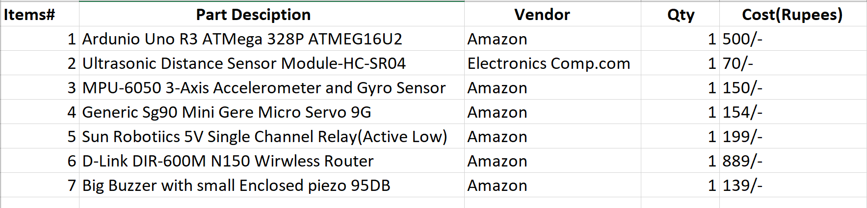

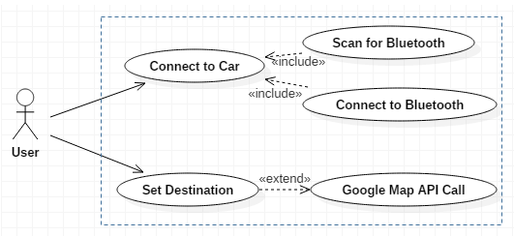
Cost Analysis:
Dependencies:
Servo Library for Arduino, Google Maps API for Arduino
                IOT, C++, C
TECHNOLOGY STACK:
USE CASES

